Slide 1
Completing your CITI training

Slide 2
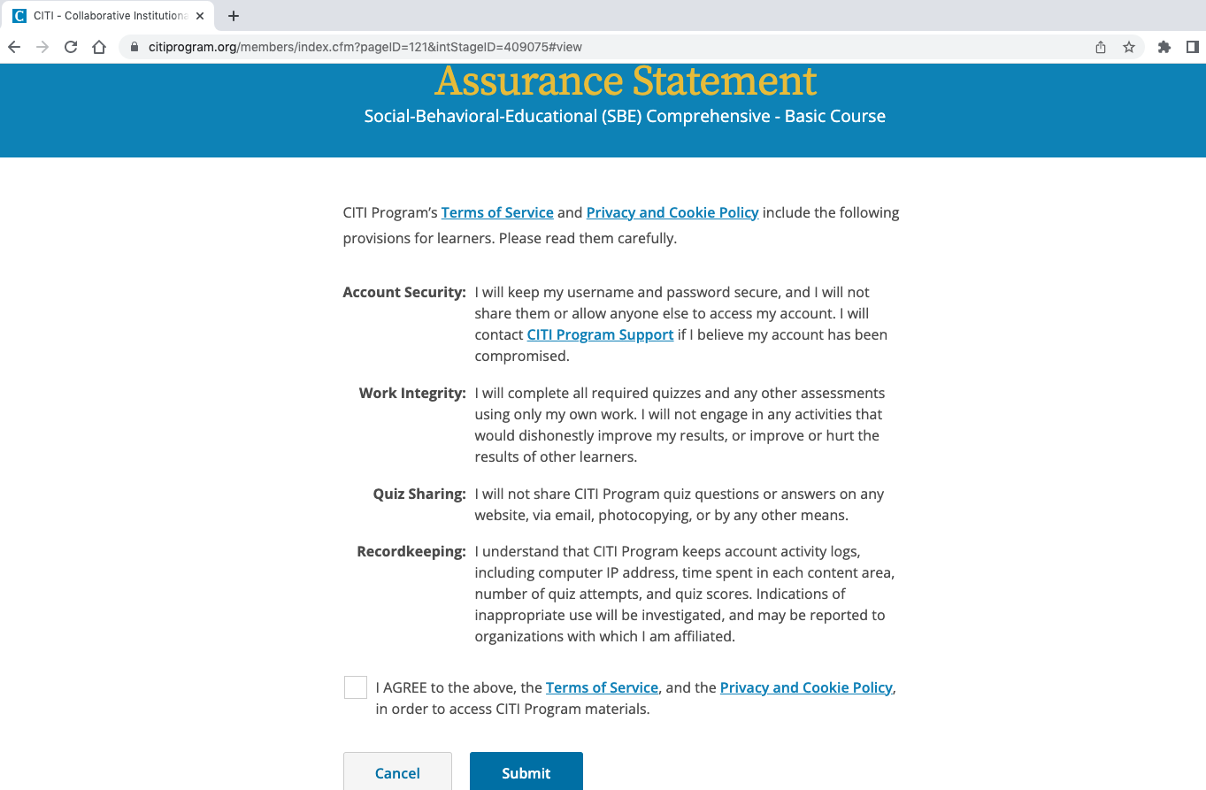
Agree to the Assurance Statement

Slide 3
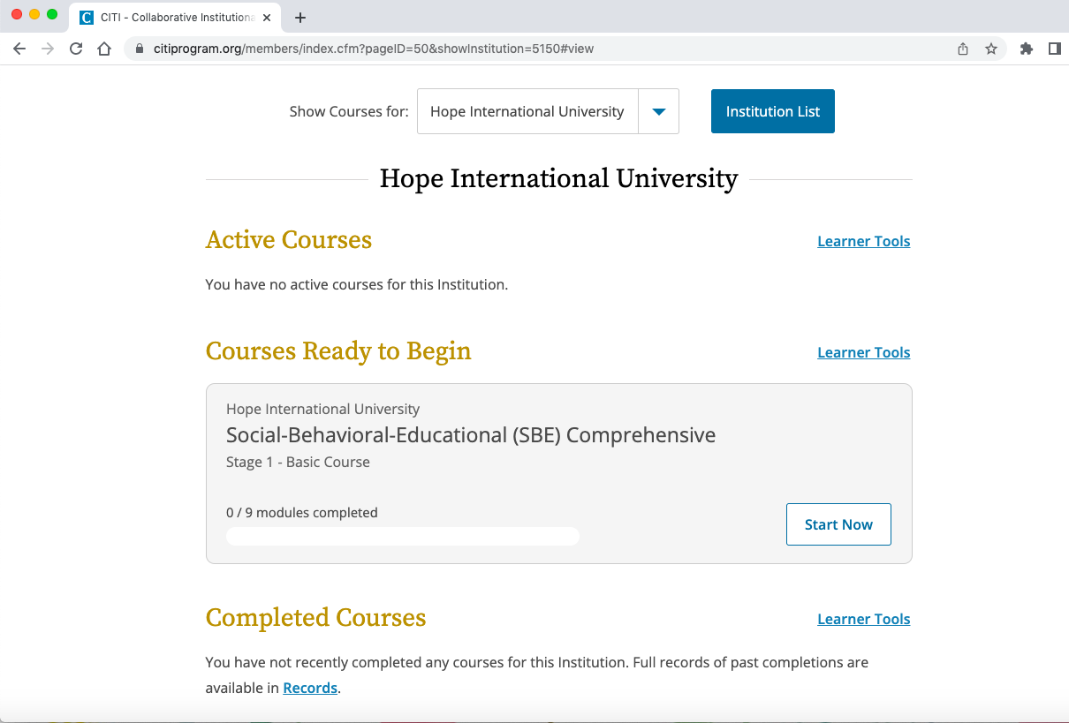
To access your course, click “Start Now”

Slide 4
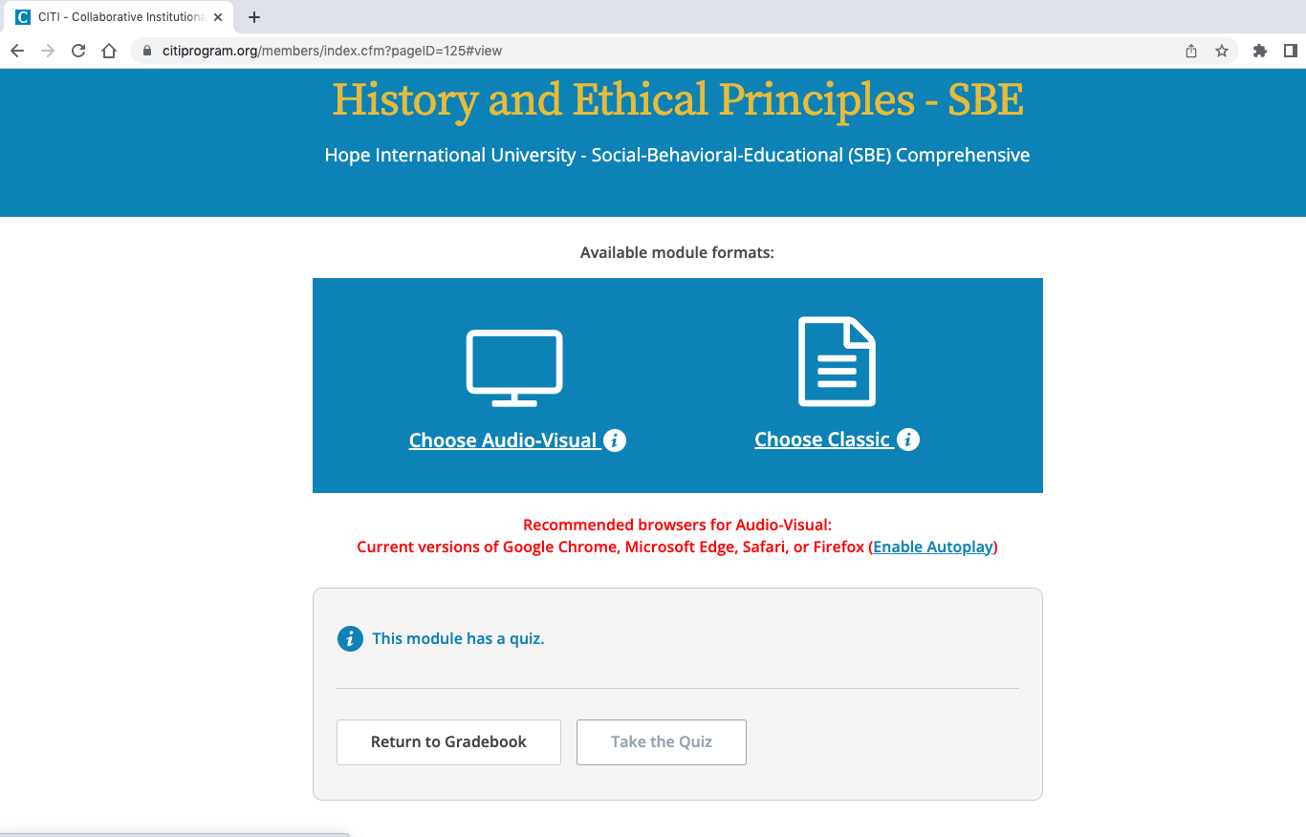
Select your format

Slide 5
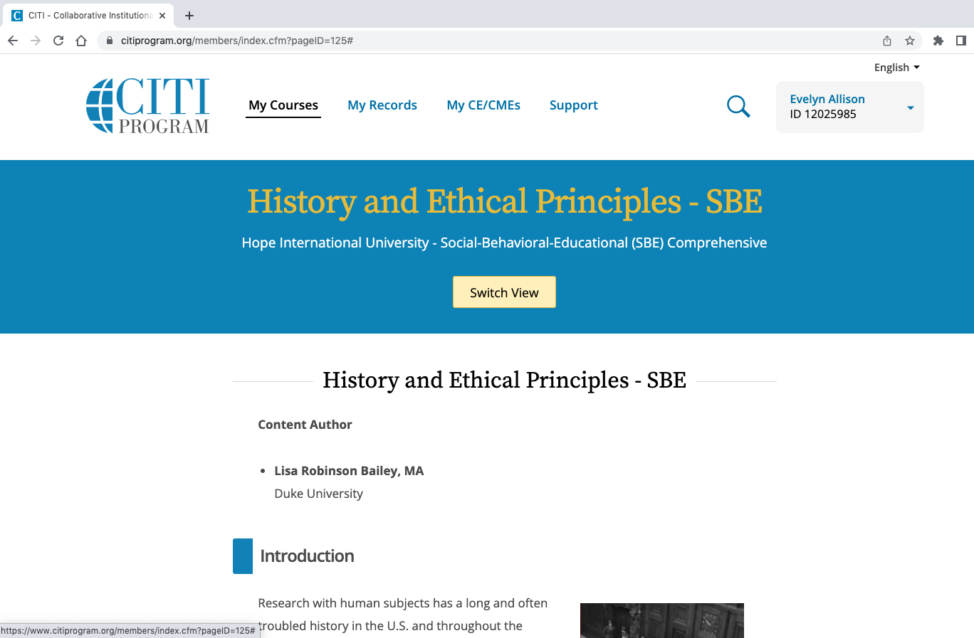
If you ever want to switch your format, click Switch View

Slide 6
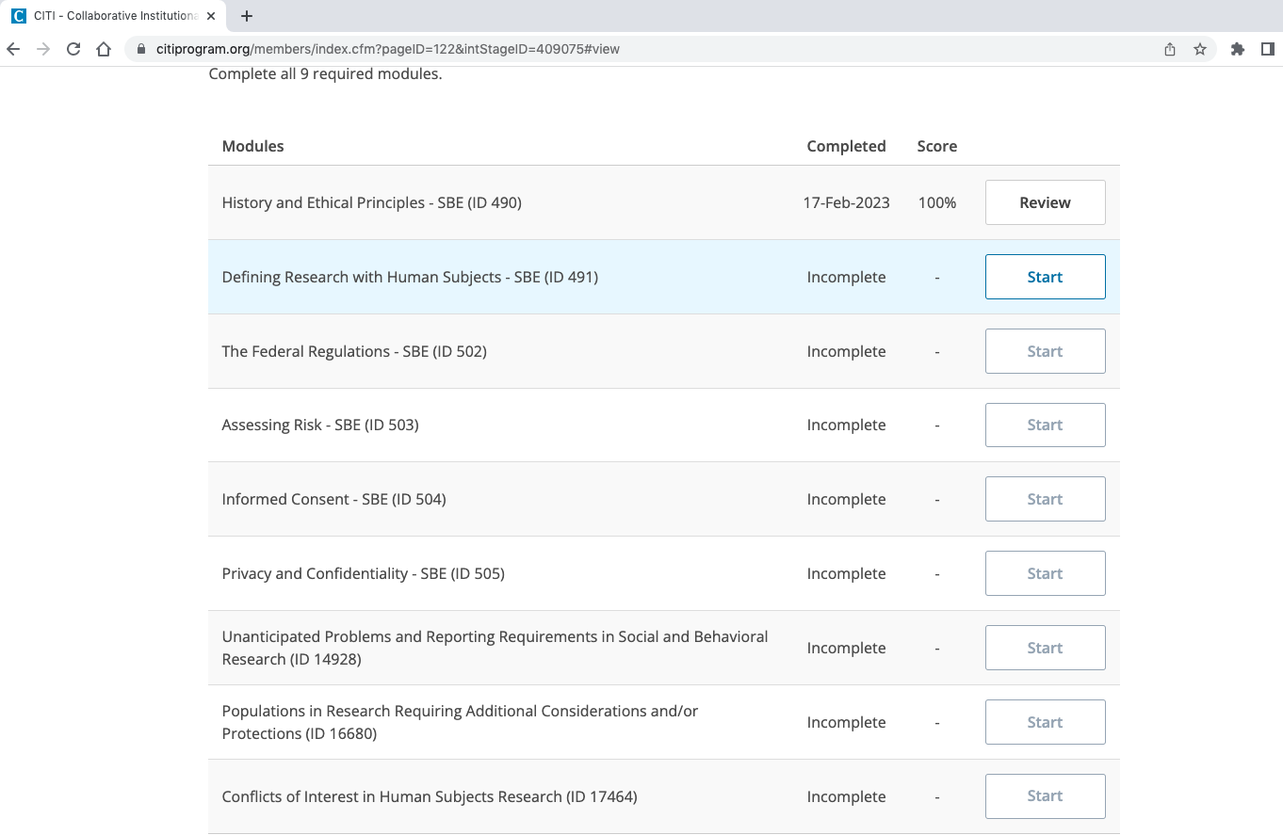
To begin a module, click “Start”

Slide 7
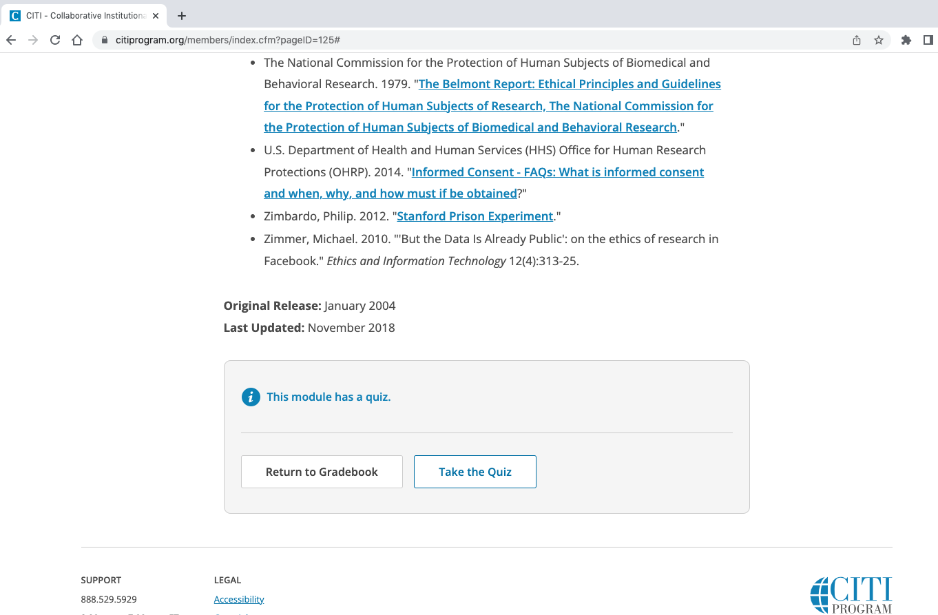
At the end of each module, you will take a quiz. To access the quiz click on “Take the Quiz"

Slide 8
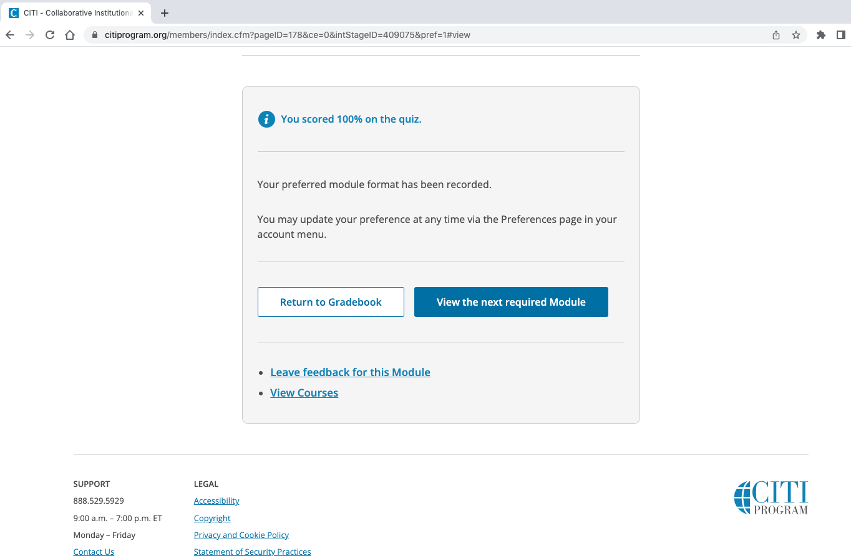
After you complete a quiz, you can either choose to move on to the next required Module, or you can return to the Gradebook.

Slide 9
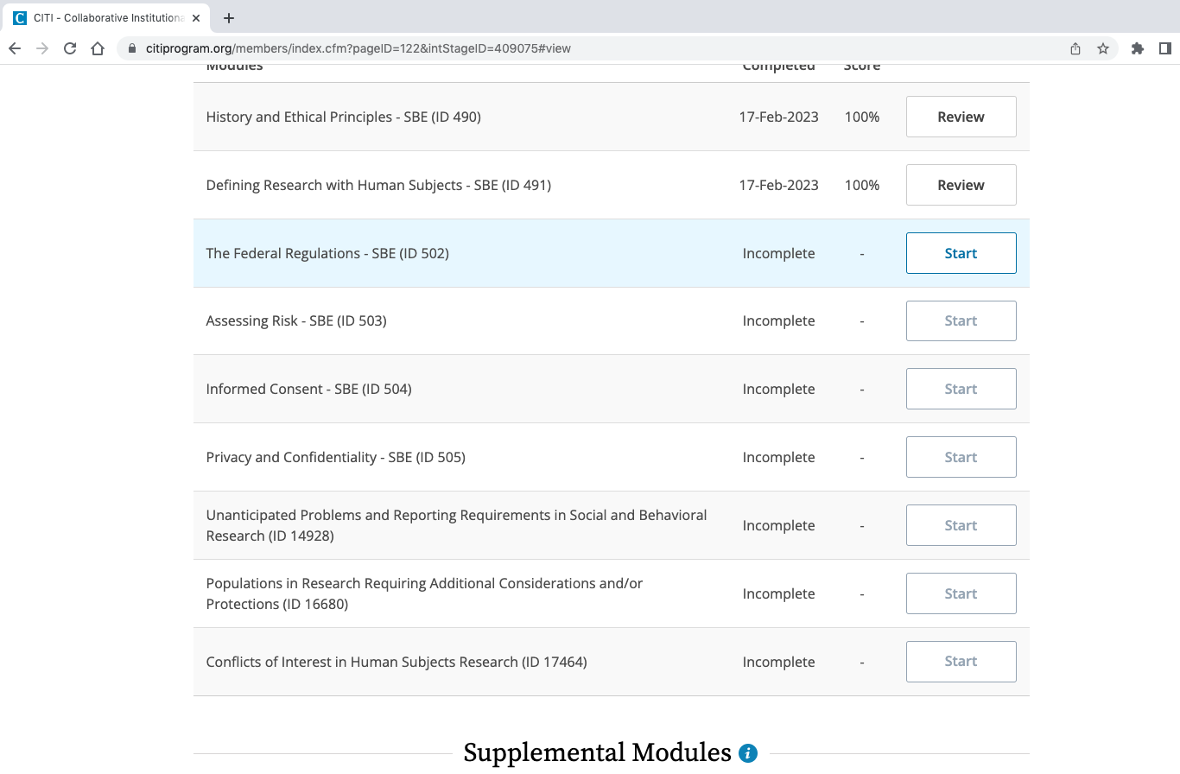
You can review completed modules by clicking “Review”. Your score and date of completion will show next to each module.

Slide 10
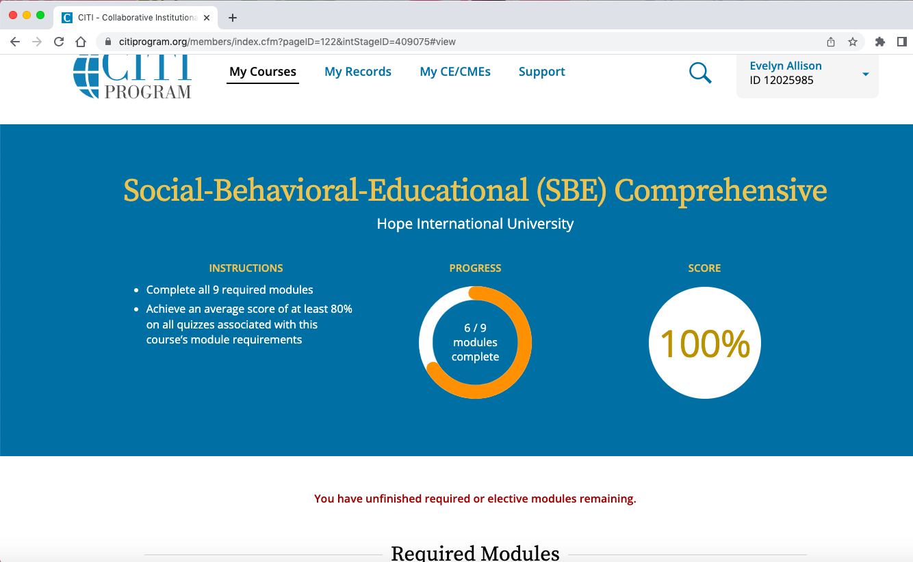
Your progress and overall score will be displayed at the top of the course page

Slide 11
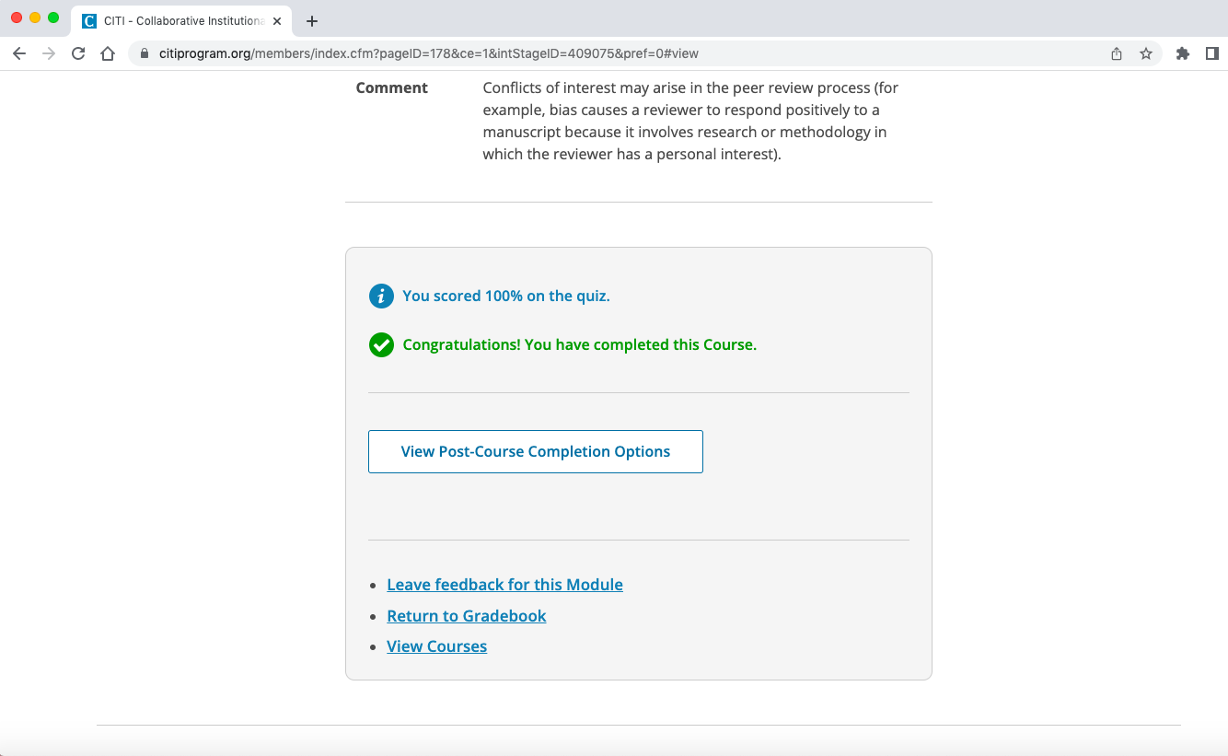
When you have completed all of the modules, you will see this. Click on “View Post-Course Completion Options to access your certificates.

Slide 12
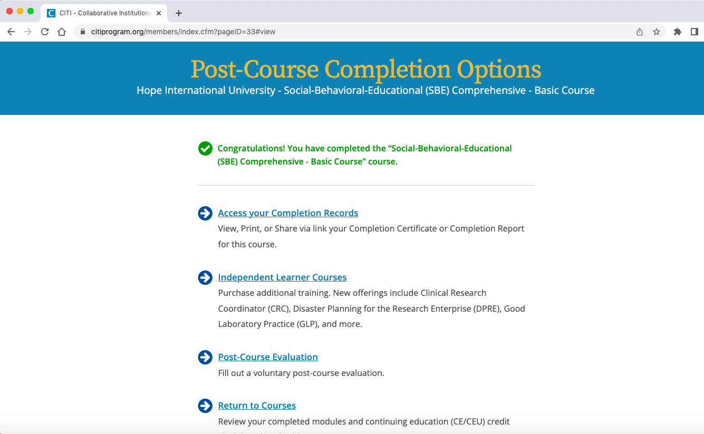
To access your completion records, click on “Access your Completion Records” and you will be able to download your certificates.

